Slide 1
RSE Policy Consultation
22nd April 2021

Slide 2
Purpose of Consultation
As a school, we would always want to deliver a curriculum which has the support of the vast majority, if not all, parents.
We believe that children will accept information which is given to them in small chunks over time and at an age appropriate level more easily than information which is ‘kept secret’ until they are in Y6.
We recognise that children need an increasing level of skill to deal with the modern world and the impact of social networking, advertising and media. Schools and parents have a responsibility to give a positive message which builds children’s resilience to the negative messages they may encounter through the easy availability of pornography / photo-shopped body images / TV programmes such as Love Island which portray sex as separate from relationships.
We would want all pupils to grow with the knowledge of natural changes before they happen, and pupils can encounter puberty at a relatively young age. For example, while the average age for a girl to begin menstruation in the UK is 12, many begin in Y6 and some in Y5. Less commonly, girls can begin their periods from 8 yrs old.

Slide 3
Changes
A new curriculum for relationships and sex education was mandatory from September 2020.
Primary schools must teach relationships education and health education, including education on mental wellbeing.
Primary schools are not required to teach sex education but as a school we would like to make the decision to deliver it, respectfully, in order to fully educate our children on life and equip them with the knowledge to make healthy and well-informed decisions.

Slide 4
Extract from DFE Statutory Guidance
To embrace the challenges of creating a happy and successful adult life, pupils need knowledge that will enable them to make informed decisions about their wellbeing, health and relationships and to build their self-efficacy. Pupils can also put this knowledge into practice as they develop the capacity to make sound decisions when facing risks, challenges and complex contexts. Everyone faces difficult situations in their lives. These subjects can support young people to develop resilience, to know how and when to ask for help, and to know where to access support.
High quality, evidence-based and age-appropriate teaching of these subjects can help prepare pupils for the opportunities, responsibilities and experiences of adult life. They can also enable schools to promote the spiritual, moral, social, cultural, mental and physical development of pupils, at school and in society. The duties on schools in this area are set out in legislation.

Slide 5
The Relationships Education, Relationships and Sex Education and Health Education (England) Regulations 2019, made under sections 34 and 35 of the Children and Social Work Act 2017, make Relationships Education compulsory for all pupils receiving primary education and Relationships and Sex Education (RSE) compulsory for all pupils receiving secondary education.
They also make Health Education compulsory in all schools except independent schools. Personal, Social, Health and Economic Education (PSHE) continues to be compulsory in independent schools.
This guidance also sets out both the rights of parents/carers to withdraw pupils from sex education (but not Relationships or Health Education) and the process that head teachers should follow in considering a request from a parent. Parents have the right to request that their child be withdrawn from some or all of sex education delivered as part of statutory RSE.
Schools are free to determine how to deliver the content set out in this guidance, in the context of a broad and balanced curriculum. Effective teaching in these subjects will ensure that core knowledge is broken down into units of manageable size and communicated clearly to pupils, in a carefully sequenced way, within a planned programme or lessons. Teaching will include sufficient well-chosen opportunities and contexts for pupils to embed new knowledge so that it can be used confidently in real life situations.

Slide 6
In all schools, when teaching these subjects, the religious background of all pupils must be taken into account when planning teaching, so that the topics that are included in the core content in this guidance are appropriately handled. Schools must ensure they comply with the relevant provisions of the Equality Act 2010, under which religion or belief are amongst the protected characteristics. At Alderman Payne, we will aim to teach RSE within the context of our values, showing respect for all cultures and faiths and underlining the importance of happy, mutually supportive and stable relationships.
Relationships Education, RSE and Health Education must be accessible for all pupils. This is particularly important when planning teaching for pupils with special educational needs and disabilities who represent a large minority of pupils. High quality teaching that is differentiated and personalised will be the starting point to ensure accessibility. At Alderman Payne, children will be taught in specific year group lessons. We will aim not to move children to different classrooms, but instead to teach within their classroom and differentiate their learning accordingly within year groups. Children will have the opportunity to ask questions or raise issues confidentially through a questions box in each classroom.

Slide 7
In teaching Relationships Education and RSE, schools should ensure that the needs of all pupils are appropriately met, and that all pupils understand the importance of equality and respect. Schools must ensure that they comply with the relevant provisions of the Equality Act 2010, (please see The Equality Act 2010 and schools: Departmental advice), under which sexual orientation and gender reassignment are amongst the protected characteristics. At Alderman Payne, we aim to answer children’s questions thoughtfully and honestly, at an age – appropriate (or understanding-appropriate) level. Subjects such as homosexuality, bisexuality and transgenderism are not taught explicitly, but may come up as part of pupil led discussions, and questions will be answered by adults in a way which encourages respect, understanding and tolerance. Children will not be taught that any of these characteristics are wrong or shameful, and any comments made to that effect will be discussed.

Slide 8
Parental Right To Withdraw Pupils from RSE
Parents have the right to request that their child be withdrawn from some or all of sex education delivered as part of statutory RSE. Parents should put a request in writing to the Headteacher.
Good practice is also likely to include the head teacher discussing with parents the benefits of receiving this important education and any detrimental effects that withdrawal might have on the child. This could include any social and emotional effects of being excluded, as well as the likelihood of the child hearing their peers’ version of what was said in the classes, rather than what was directly said by the teacher.
Head teacher will grant a request to withdraw a pupil from any sex education delivered in primary schools, other than as part of the science curriculum.

Slide 9
Science Curriculum
Parents may not withdraw pupils from Science lessons on reproduction which form part of the statutory National Curriculum.
In KS1 - Pupils should be taught to notice that animals, including humans, have offspring which grow into adults. They should also be introduced to the processes of reproduction and growth in animals. The focus at this stage should be on questions that help pupils to recognise growth; they should not be expected to understand how reproduction occurs. The following examples might be used: egg, chick, chicken; egg, caterpillar, pupa, butterfly; spawn, tadpole, frog; lamb, sheep. Growing into adults can include reference to baby, toddler, child, teenager, adult.

Slide 10
Science Curriculum
In Upper KS2 (Y5/6) - Pupils should be taught to describe the differences in the life cycles of a mammal, an amphibian, an insect and a bird and describe the life process of reproduction in some plants and animals. Pupils should find out about different types of reproduction, including sexual and asexual reproduction in plants, and sexual reproduction in animals. They might observe changes in an animal over a period of time (for example, by hatching and rearing chicks), comparing how different animals reproduce and grow.
Pupils should be taught to describe the changes as humans develop to old age. Pupils should draw a timeline to indicate stages in the growth and development of humans. They should learn about the changes experienced in puberty. Pupils could work scientifically by researching the gestation periods of other animals and comparing them with humans; by finding out and recording the length and mass of a baby as it grows.

Slide 11
Our Resources
The programme that we use
The types of resources
Year group overviews

Slide 12
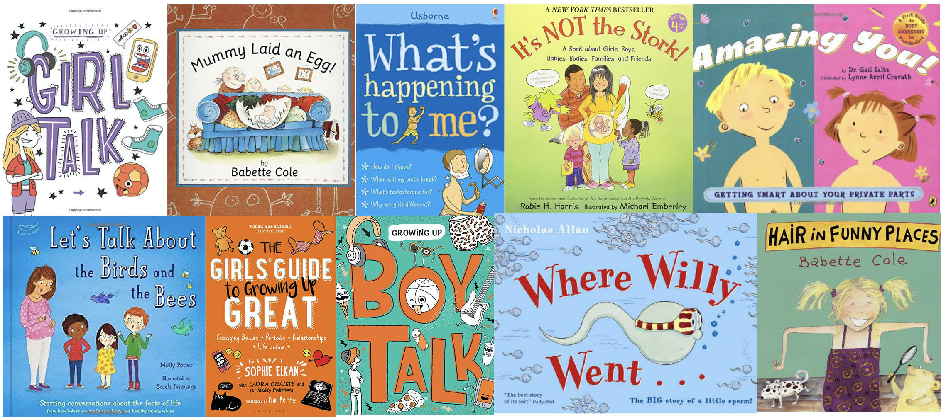

Slide 13
Any questions?

