Slide 1
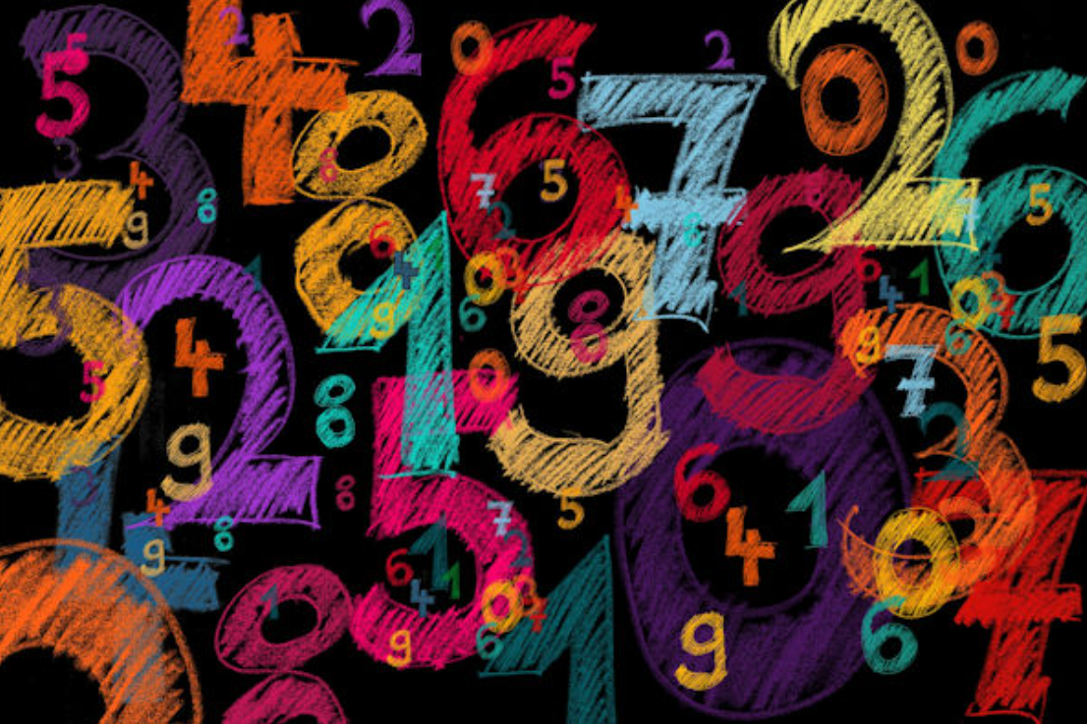
Multiplication Tables Check (MTC)

Slide 2
Who will take the Multiplication Tables Check?
The Multiplication Tables Check (MTC) is a times tables test to be taken online by children at the end of year 4.
It is not based on what Times tables they are on in class, everyone will participate and attempt the check.

Slide 3
What will be tested in the
Multiplication Tables Check?
The check will only assess multiplication facts and not the corresponding division facts. It will test up to 12 × 12.
The 1 times table is not included (apart from in practice questions).
There will be a particular focus on the 6, 7, 8, 9 and 12 times tables but the other times tables will also be included.

Slide 4
What happens during the check?
Miss Whitmore will take the children out individually to somewhere quiet during the week in June, the children will know what day they are going so it is not a surprise.
They will have chosen if they want to do it on a laptop or an ipad, as we practice on Ipads more they will normally lean towards that, but it is their choice on what they feel most confident with.
They then complete the Multiplication Tables Check which has 25 questions and 3 practice questions.
Children will have 6 seconds to answer a question with a 3 second gap between questions.

Slide 5
Will there be a pass mark?
There is to be no threshold or pass mark and individual school results will not be published in performance tables!
The purpose of the test is to determine whether pupils can recall their times tables fluently, which is essential for future success in mathematics.
It will help us to identify pupils who have not yet mastered their times tables, so that additional support can be provided.

Slide 6
What does school do to support the children?
We practice a different times table each week.
We use songs daily to help with recalling the facts.
We also use different activities 3-4 times a week to help with recall of the focus times table.

Slide 7
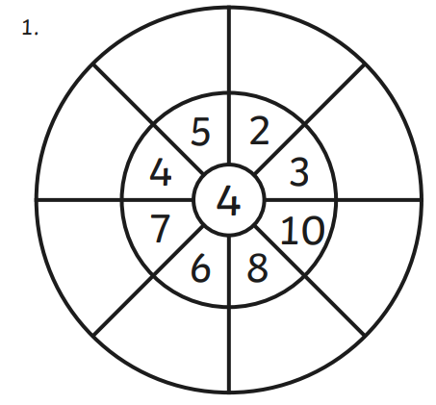
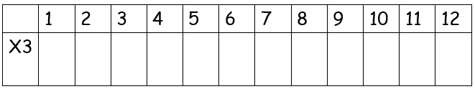
What school does to support the children?
For the song, we use the same YouTube channel, Laugh Along and Learn, for all times tables.
https://www.youtube.com/watch?v=uV0ZL2h8IRg
Activities we use include:
Multiplication Targets.
Times Tables Bingo.
Times Tables lollipop sticks/cards.
Times Table grids.

Slide 8
What school does to support the children?
After the February half term we will start weekly practice of the Multiplication Tables Check.
We will use Timestables.co.uk , as it is set out very similar to the real test.
https://www.timestables.co.uk/multiplication-tables-check/
We will then do a practice on the real website later on in the year so the children are familiar with the logging in process and layout.

Slide 9
What can parents do to support their children?
Daily practice of the times tables: this could be through verbally asking questions, asking them to write them down or through different games.
Using Timestables.co.uk , as it is set out very similar to the real test.
https://www.timestables.co.uk/multiplication-tables-check/
Using the songs: https://www.youtube.com/watch?v=uV0ZL2h8IRg but also on Spotify or Apple music if you type in the times table they want to practice there is lots of different songs for on the go.

Slide 10
What can parents do to support their children?
Games such as:
Times Tables cards: Pick a times table and then as you flip the card it is the first person to say the answer wins the card. For example if we are practicing the 4 times tables, if I flip a 5 card it is the first to answer 4 x 5.
Lollipop Sticks
Using dice, Roll two dice and then answer the multiplication.
Rock Paper Scissors: Instead of chosing rock paper or scissors, chose 1,2,3,4,5 fingers and then race to answer the multiplication.
Times Table Tennis: Chose a times table and then go back and fourth counting in the chosen multiplication.

Slide 11
Any questions?

